Slide 1
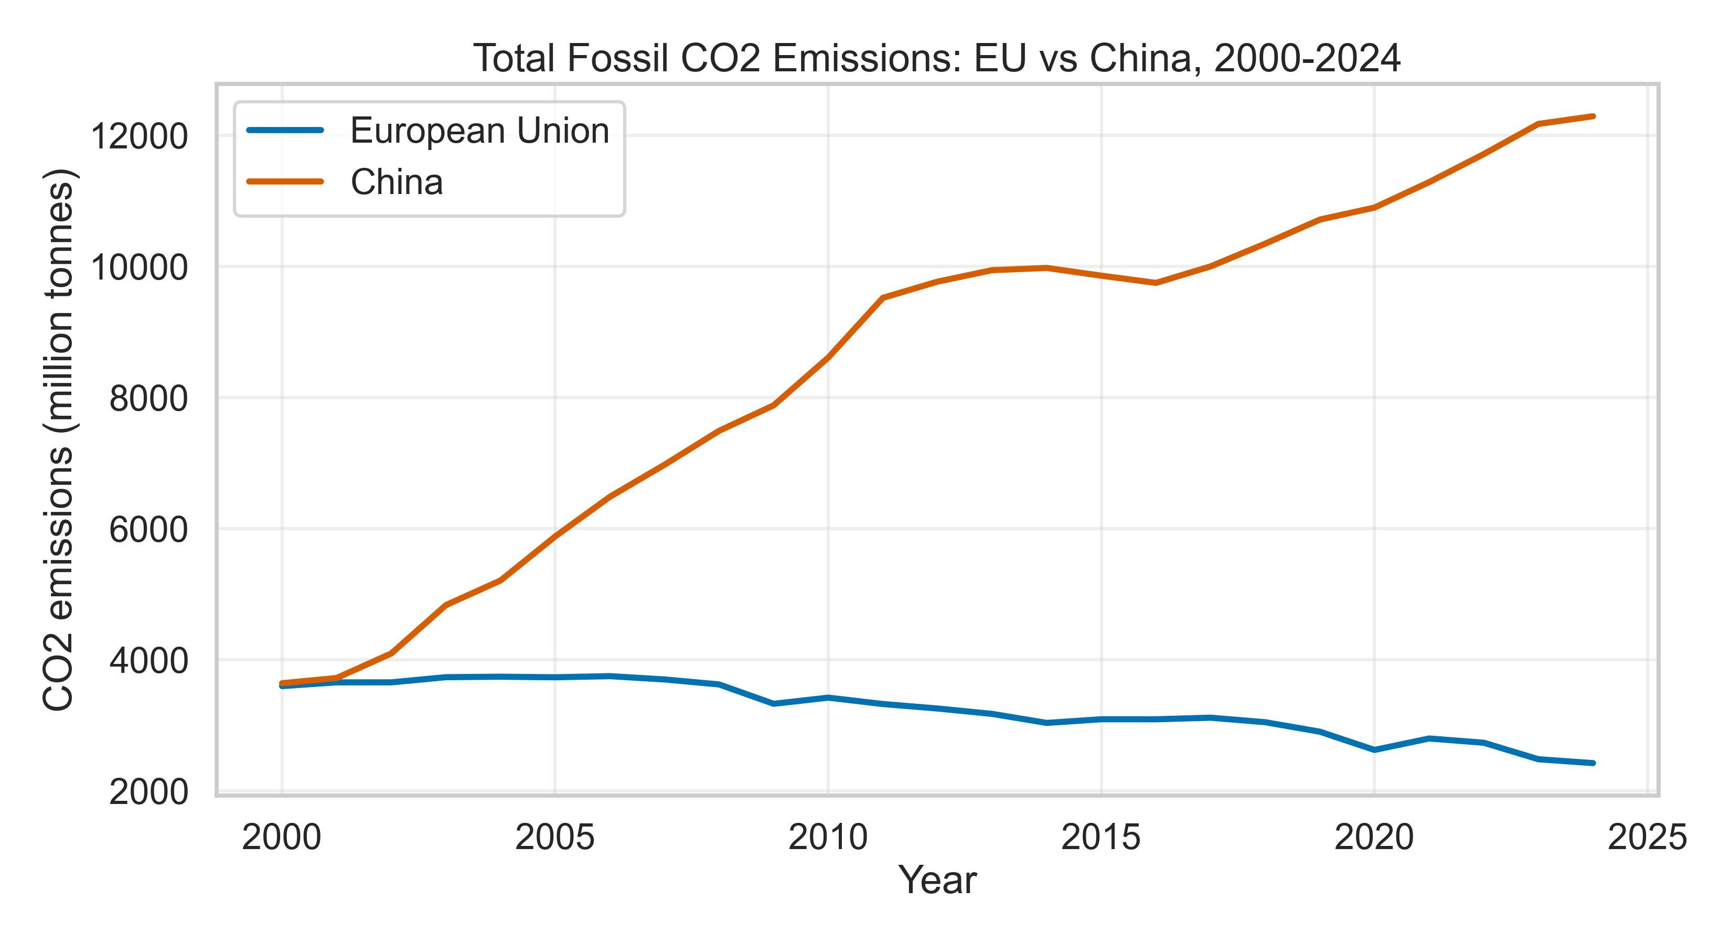
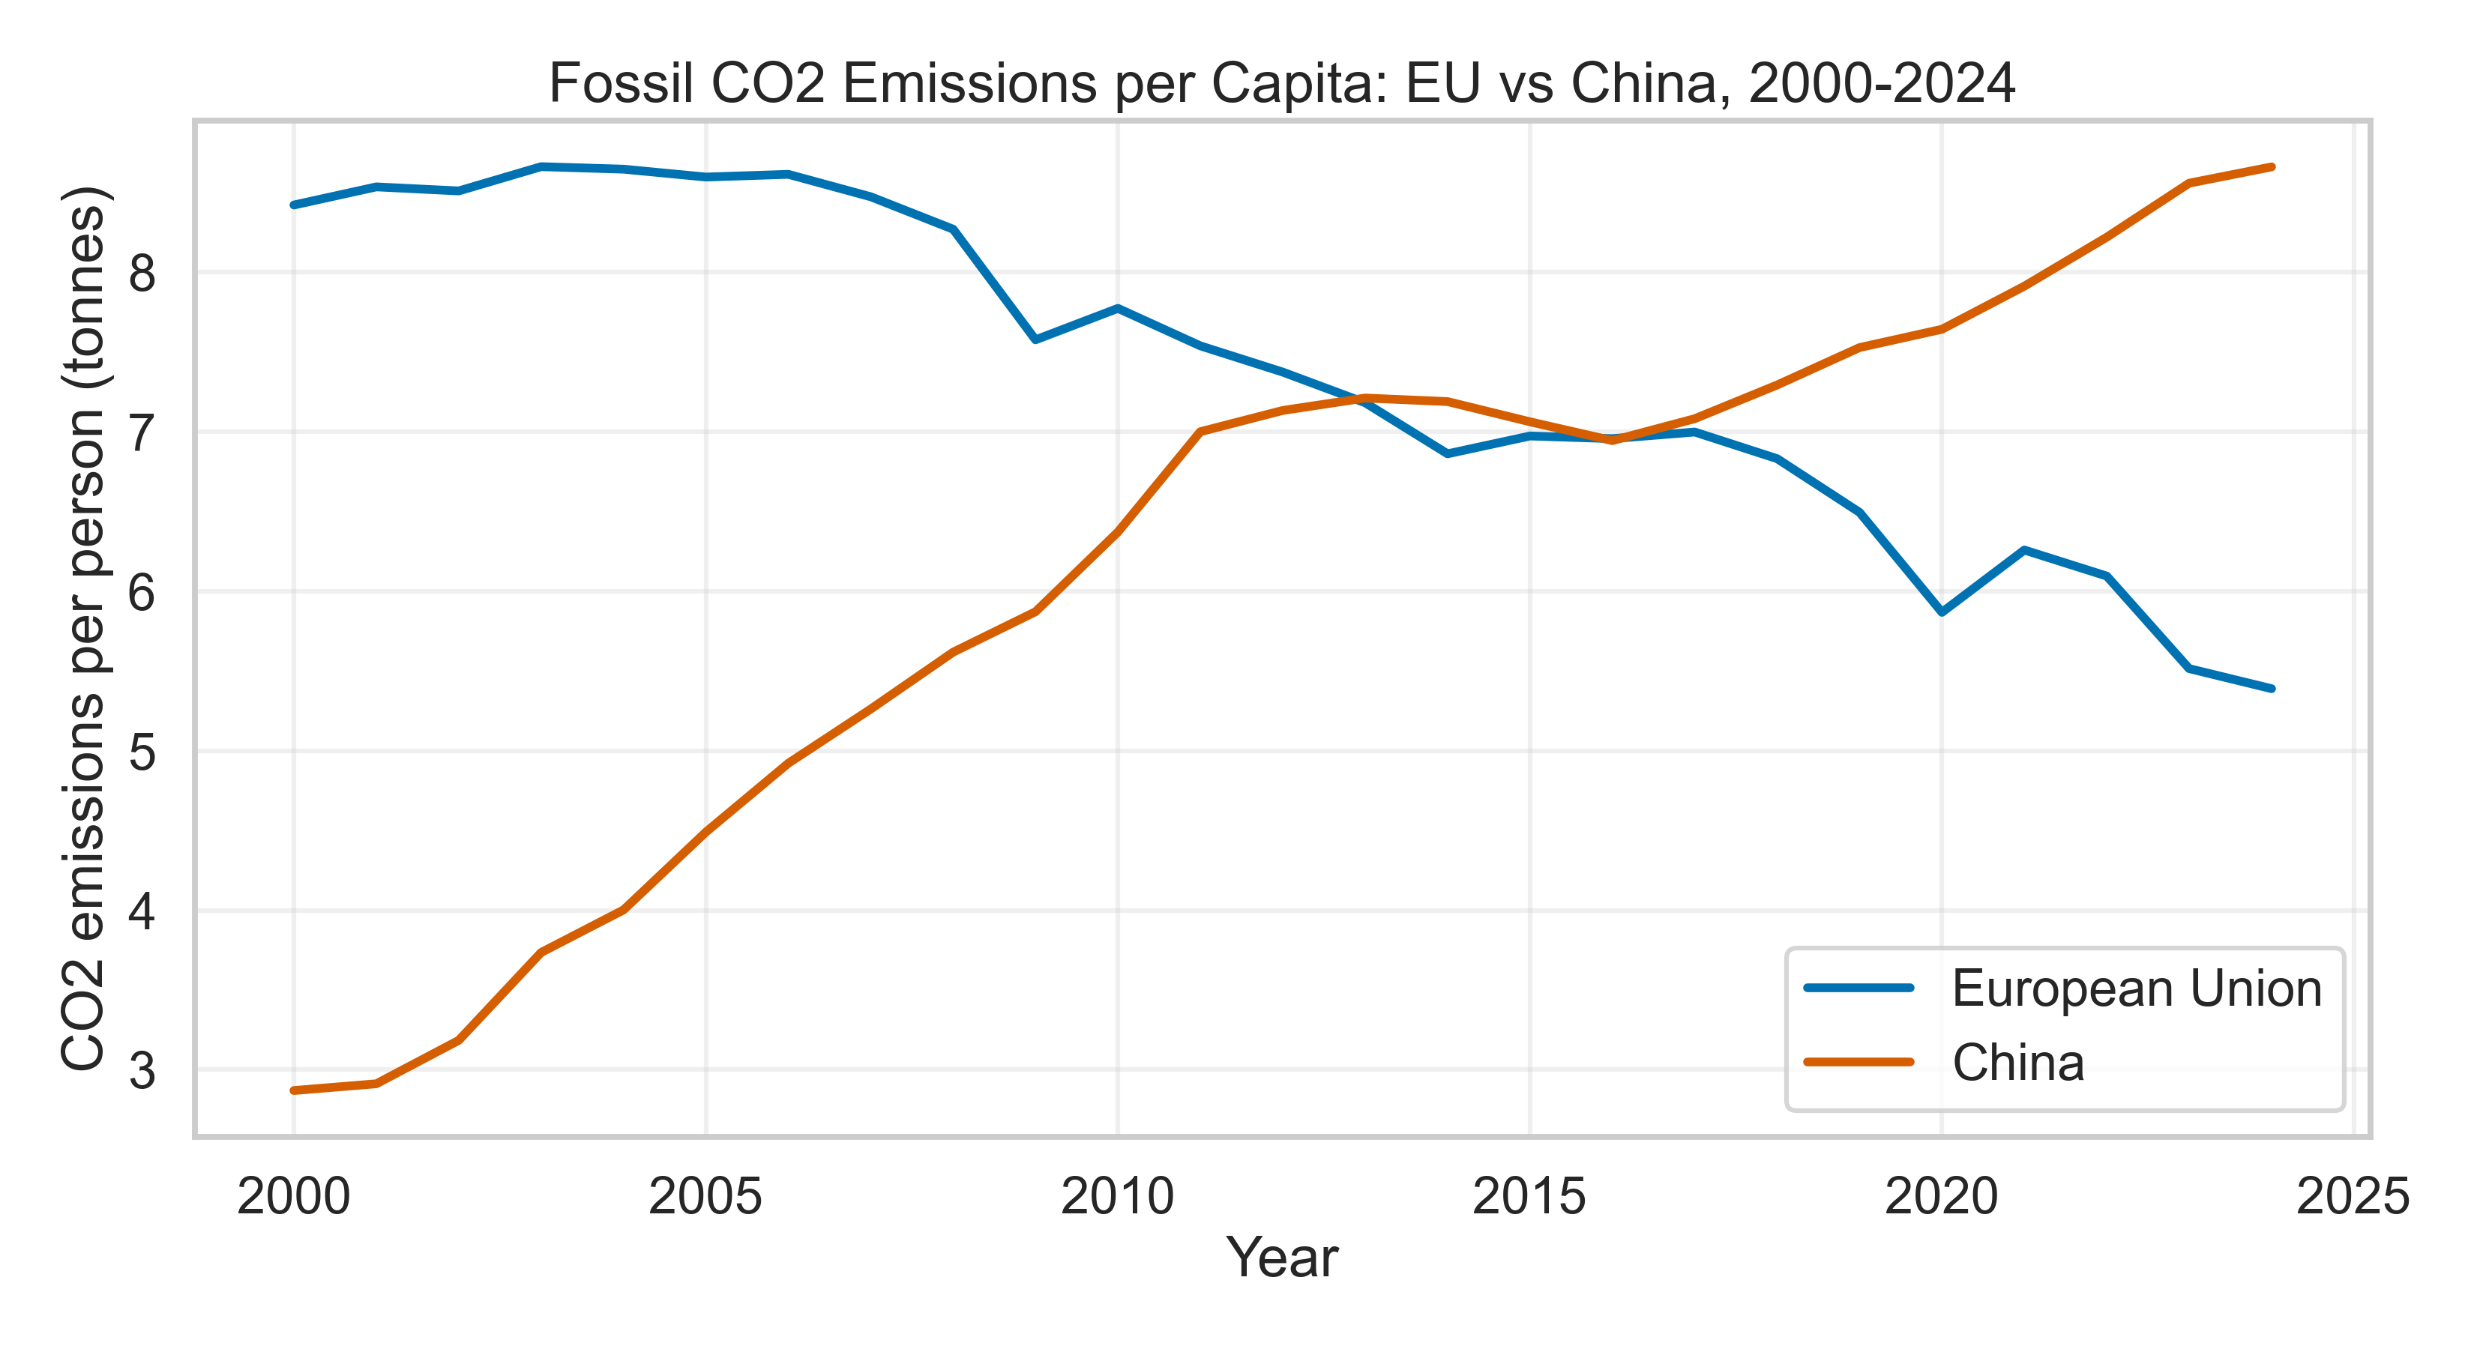
China and EU Fossil CO2 Emissions, 2000-2024
Total: annual emissions; EU is the combined total of its 27 member states.
Per capita: EU emissions divided by total EU population.

Slide 2
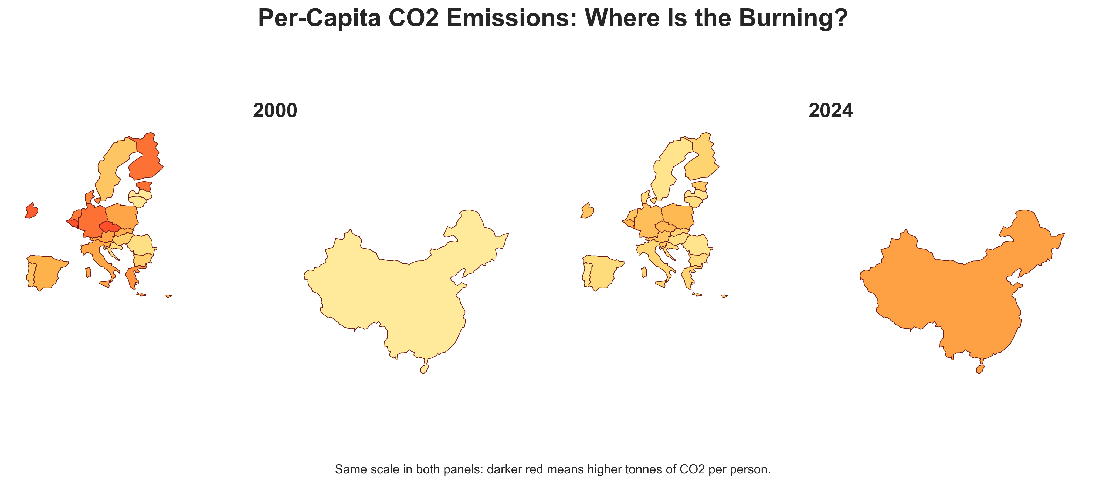
Per-Capita CO2 Emissions by Country
With the same color scale, the EU's lighter 2024 map shows lower per-capita emissions than in 2000.

